Slide 1
Signal Processing
Tirgul 1 – Trigonometric Functions (amplitude, phase and frequency), Sampling Theorem: Nyquist frequency, Aliasing

Slide 2
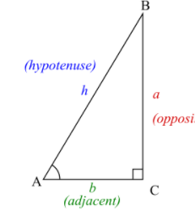
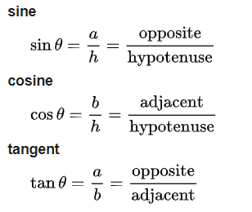
Trigonometric Functions
Real functions, relate an angle at a triangle to two side lengths. Will take a part in the course.
The most basic functions are:

Slide 3
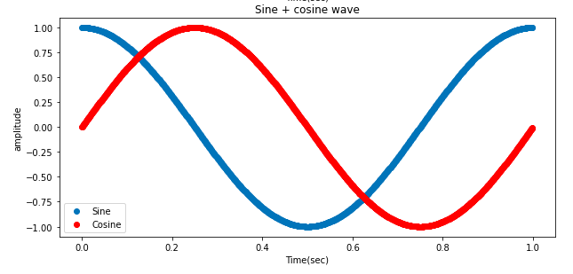
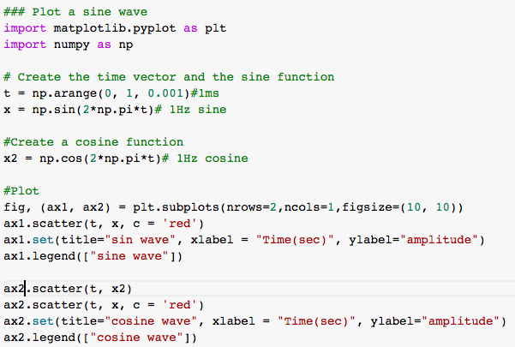
Reminder: create and plot a sine\cosine wave

Slide 4
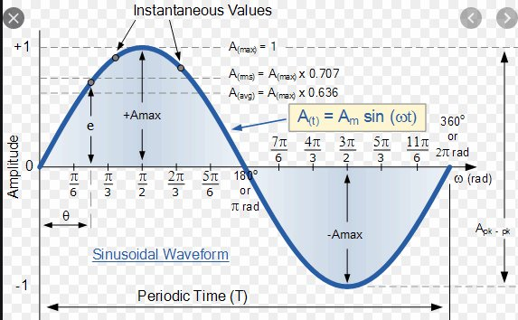
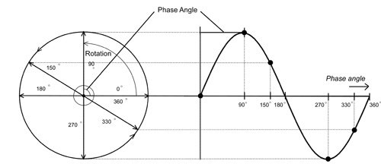
Sine and cosine waves - unit circle and time
https://jackschaedler.github.io/circles-sines-signals/sincos.html#:~:text=We%20can%20describe%20the%20shape,of%20the%20resulting%20sine%20wave.

Slide 5
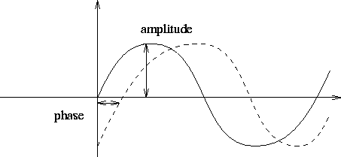
3 main parameters of the sine\cosine
Frequency - how many cycles / second.
Amplitude - the range of values in the y-axis( usually symmetric e.g. -2 and 2).
Phase - a shift from the original starting point
in the x-axis.

Slide 6

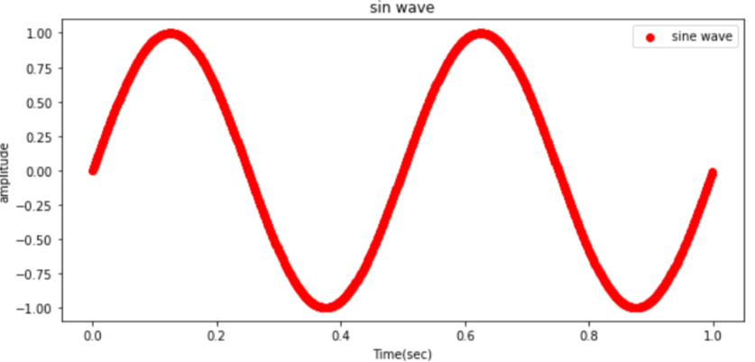
Set the frequency of the sine\cosine
For two-cycles sine wave along 1 second:
Two-cycles/second (2*2*pi)
For n cycles/second, n*2*pi

Slide 7

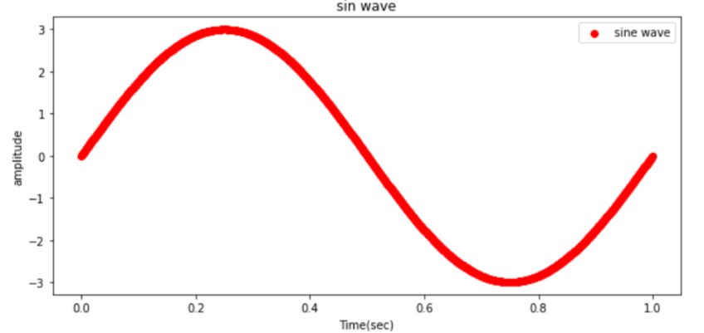
Set the amplitude of the sine\cosine
We multiply the whole expression by the amplitude
We have 1Hz sine wave with amplitude between -3 to 3

Slide 8
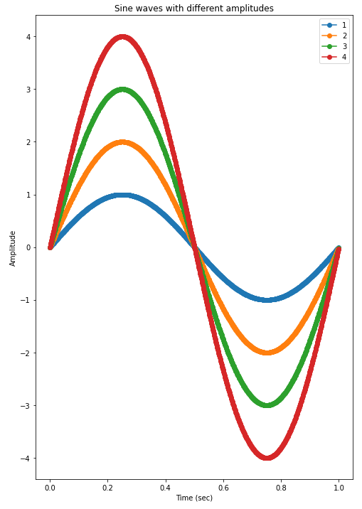
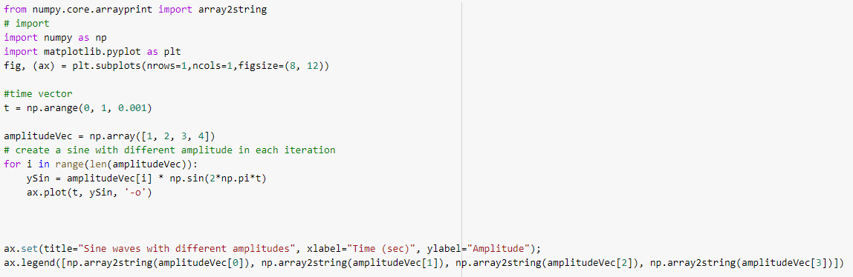
Example of different amplitudes

Slide 9
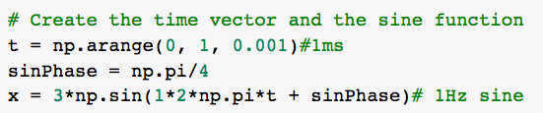
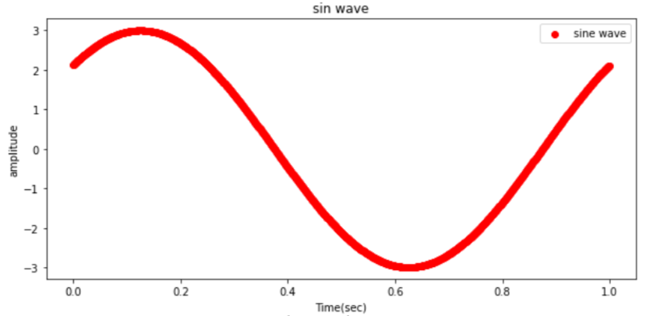
Set the phase of the sine\cosine
We shift the sin by pi/4

Slide 10
Phase shift between sine and cosine
Note: the phase difference between cosine and sine is pi/2 (90 degrees)
Therefore:
sin(t.*(2*pi) + pi/2) == cos(t.*(2*pi))

Slide 11
Trigonometric Functions example on colab
Tirgul 1 – Trigonometric, Sampling Theorem, Aliasing.ipynb
(will be uploaded to Moodle)

Slide 12
Live Exercise :
Plot a sine wave with an amplitude of 2.5 and a phase shift of (3*pi)/2.
Over the same plot, plot a cosine wave with an amplitude of 3.4 and a phase shift of pi/4.
Don't forget to add title, x and y-labels.

Slide 13
The sampling theorem
&
Aliasing

Slide 14
Sampling rate
samplingRate(Hz) = 1 / (time interval between points)
Example #1:
np.arange(0, 1, 0.01) - we sample every 10ms:
1/0.01 = 100Hz -> the sampling rate is 100Hz
Example #2:
np.arange(0, 1, 0.001) - we sample every 1ms (most common):
1/0.001 = 1000Hz -> the sampling rate is 1000Hz

Slide 15
Nyquist frequency
Sample the signal at a frequency higher than 2 times of the maximal frequency in the signal
f_{s} > 2f_{max}

Slide 16
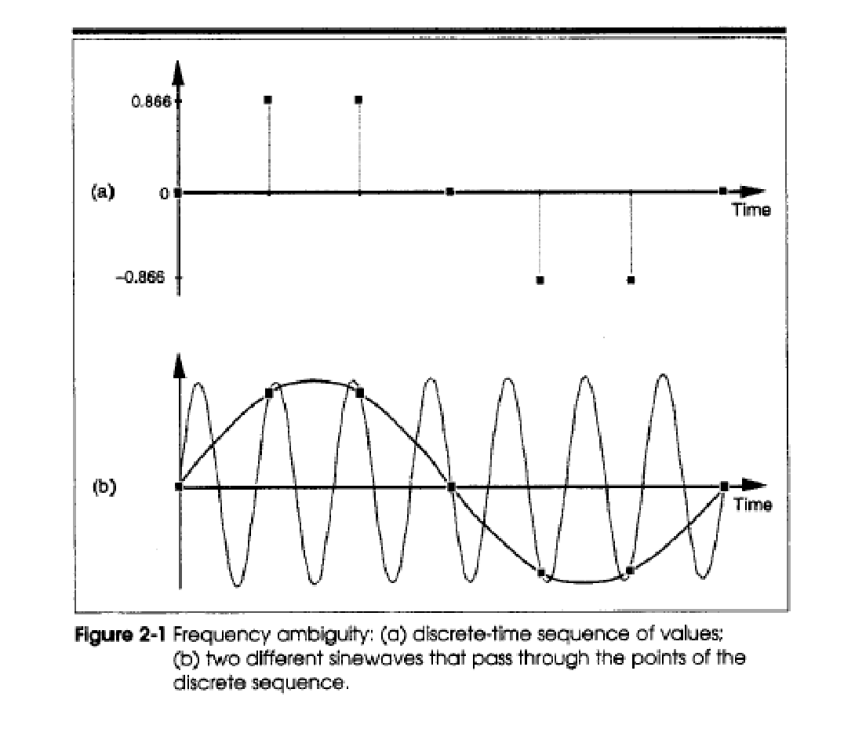

Aliasing
When sampling under the Nyquist rate we will get inaccurate sampling of our signal.

Slide 17
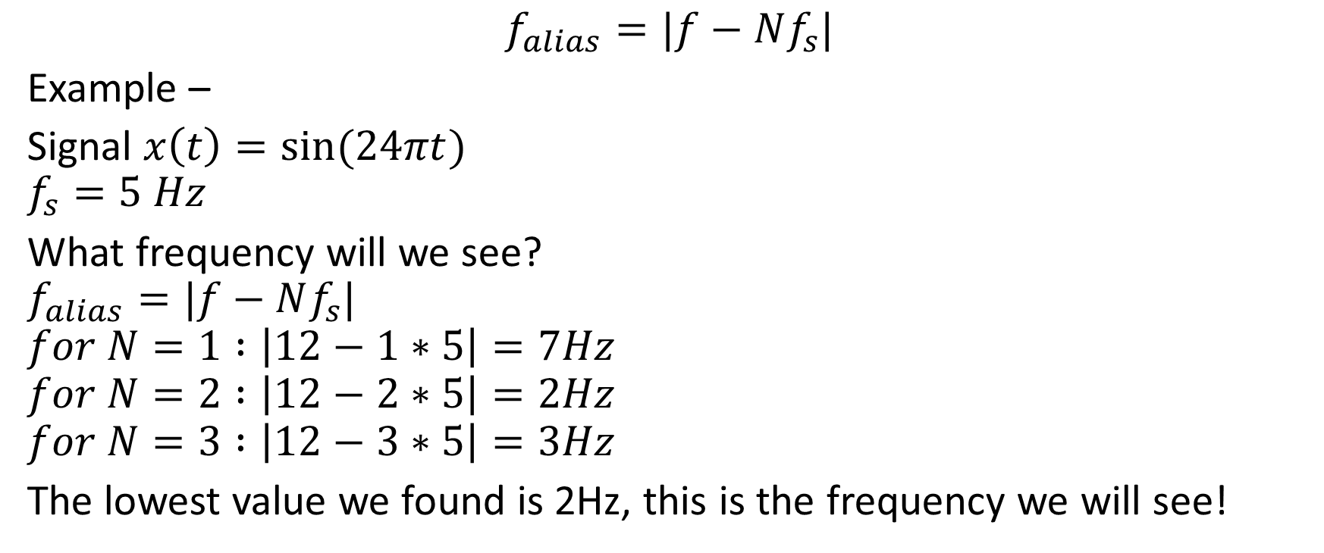
Aliasing – Example 1

Slide 18
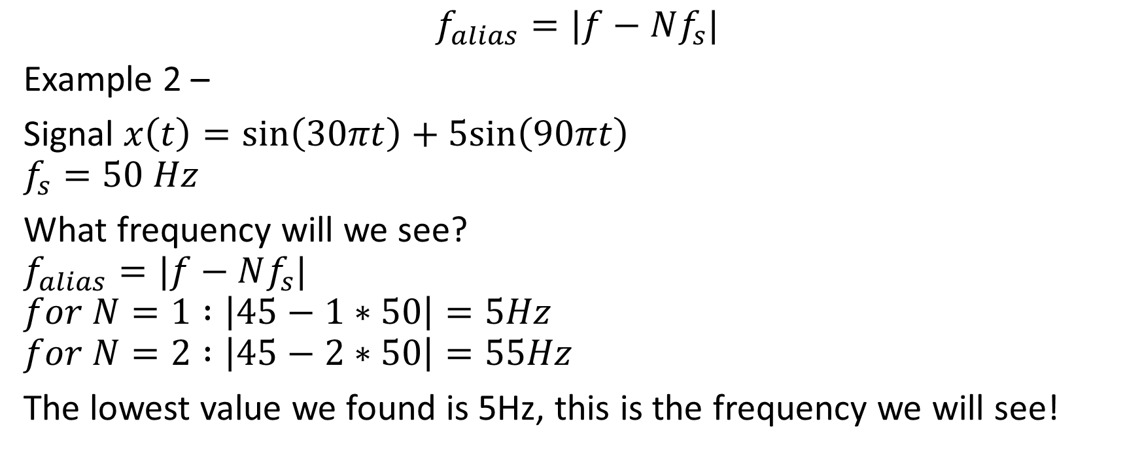
Aliasing – Example 2
j

Slide 19
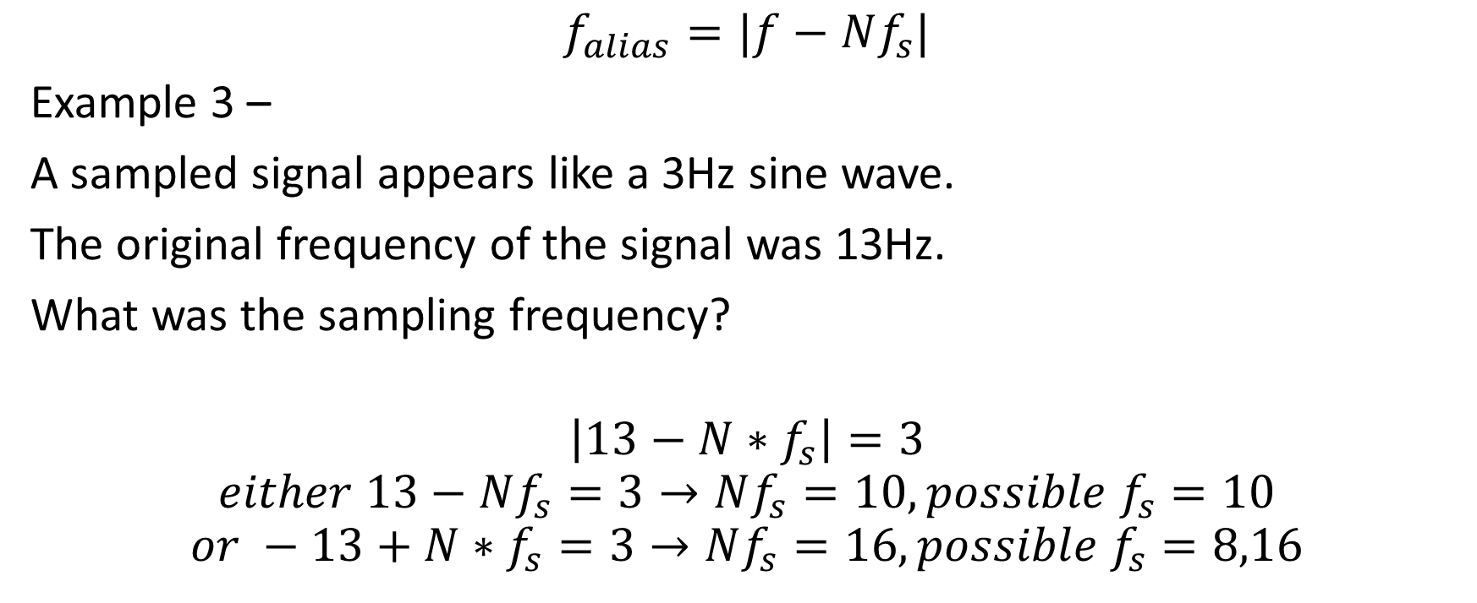
Aliasing – Example 3

Slide 20
Sampling theorem & Aliasing example on colab
Tirgul 1 – Trigonometric, Sampling Theorem, Aliasing.ipynb
(will be uploaded to Moodle)

